Slide 1
Parallel Microcomputer Interfacing Techniques for the Real World
  Switches, LEDs,
  7-Segment Displays, Multiplexing techniques
  Keypads, Software Debouncing
  High Current DC Output switching: Solenoids etc
  Opto-Isolated Inputs/Outputs
  Pulse width Modulation – H-Bridge controller for DC motors
  Stepper Motor Controller
  Incremental and Absolute Motor Position Control
©Paul Davies. Not to be copied, used, or revised without explicit written permission from the copyright owner.
This lecture may contain animations and is best viewed as a slide show

Slide 2
Parallel Ports for Switch and LED Input/Output
Problem 1
Write a 'C' program to continuously copy the Switch settings on Port A to the LEDs on Port B.
Eight Switches
Assume the following Port Addresses:
Port A Data Register at Address = 0x1000
Port B Data Register at Address = 0x1002
Port A
Dual 8 Bit Parallel IO Ports
Eight LEDs
Port B

Slide 3
Software for Switch Monitoring and LED control
void main()
{
// set up pointers to the 8 bit parallel IO ports A and B, Note casting of ints to
// unsigned char pointers and the use of ‘volatile’ meaning points to data that
// ‘can change without warning’.
volatile unsigned char *PortA = (volatile unsigned char *)(0x1000) ;
volatile unsigned char *PortB = (volatile unsigned char *)(0x1002) ;
  while(1)
{
*PortB = *PortA; // continuously copy IO Port A (switches) to IOPort B (leds)
}
}

Slide 4
Seven Segment Display Control
Problem 2
Write a function in C/C++ to display data in the range 0-9 on a 7 segment common anode display connected to Port B with segment ‘a’ connected to the l.s.b (bit 0) and segment ‘g’ to the bit 6. The decimal point ’.’ is controlled by Bit 7.
5v
anode
a
a
b
a
b
b
f
c
8 Bit Parallel IO Port
c
g
d
d
0
e
e
c
e
Port B
d
f
f
7
g
g
‘0` turns LED OFF
‘1’ turns LED ON
‘.’
Note Transistor buffer to provide better current sourcing for big displays
‘.’

Slide 5
Seven Segment Display Look-Up Table
BCD to seven segment conversion can be handled via a look up table, i.e. an array in C.
The table below gives the binary values for the segments a-g required to display numbers 0-9.
Logic 1 turns on transistor shorting cathode to ground, turning on segment
5v
Anode
a
Table Entry | Binary Data | Display
Table[0] Table[1] Table[2] Table[3] Table[4] Table[5] Table[6] Table[7] Table[8] Table[9] | ‘.’ g f e d c b a 0 0 1 1 1 1 1 1 0 0 0 0 0 1 1 0 0 1 0 1 1 0 1 1 0 1 0 0 1 1 1 1 0 1 1 0 0 1 1 0 0 1 1 0 1 1 0 1 0 1 1 1 1 1 1 0 0 0 0 0 0 1 1 1 0 1 1 1 1 1 1 1 0 1 1 0 1 1 1 1
a
b
a
b
b
f
c
c
g
d
d
e
e
c
e
d
f
f
g
g
‘.’
‘.’
Common Anode 7 Segment Display:
Logic 0 turns segment ON

Slide 6
Seven Segment Display Look-Up Table
The 1st stage is to generate the lookup table.
Assuming segment ‘a’ is connected to bit 7 and segment ‘g’ to bit 0 on Port B, we arrive at the following table of hex constants for the digits 0-9.
This example assumes we don’t, by default, want the decimal point turned on. If we did, we could easily OR the data read from the array with binary [10000000] before writing it to the display on Port B
5v
anode
Table Entry | Binary Data | Hex Data | Display
Table[0] Table[1] Table[2] Table[3] Table[4] Table[5] Table[6] Table[7] Table[8] Table[9] | ‘.’ g f e d c b a 0 0 1 1 1 1 1 1 0 0 0 0 0 1 1 0 0 1 0 1 1 0 1 1 0 1 0 0 1 1 1 1 0 1 1 0 0 1 1 0 0 1 1 0 1 1 0 1 0 1 1 1 1 1 1 0 0 0 0 0 0 1 1 1 0 1 1 1 1 1 1 1 0 1 1 0 1 1 1 1 | 0x3F 0x06 0x5B 0x4F 0x66 0x6D 0x7E 0x07 0x7F 0x6F
a
a
b
a
b
f
b
c
c
g
d
d
e
e
c
e
d
f
f
g
g
‘.’
‘.’

Slide 7
Seven Segment Display Driver Software
// A function to take a number in the range 0-9 and map that to a 7 segment display
void BCD_Display( int data) // ‘data’ represents the number to display in range 0-9
{
static unsigned char BCD[ ] = { 0x3F, 0x06, 0x5B, 0x4F, 0x66, 0x6D, 0x7E, 0x07, 0x7F, 0x6F } ;
volatile unsigned char *PortB = (volatile unsigned char *)(0x1002) ;
// check data value is in valid range,
// if so look up data in table and output it to display
if( data >=0 && data <= 9) // data valid i.e. in range 0-9?
*PortB = BCD[ data ] ; // output data from lookup table
else // invalid, i.e. outside range?
*PortB = 0 ; // invalid data so display nothing
}

Slide 8
Multiplexed Seven Segment Displays
Problem 3
Write a function in C/C++ to display the value of an integer in the range 0 – 99 on two multiplexed 7 segment displays
Display enabled by logic '1' on this signal
Port A
0
5v
5v
1
anode
anode
a
a
0
a
b
a
b
a
b
b
b
f
f
c
c
c
g
g
d
d
d
Port B
e
e
c
e
e
c
e
d
d
f
f
f
g
g
g
‘.’
‘.’
‘.’
7

Slide 9
Multiplexed Seven Segment Display Software
Solution:
Assume Port A bits 0 and 1 control activation of one or other 7-segment display.
Assume Port B controls the 7-segment data.
This example also dispenses with checking the validity of the display data.
static unsigned char BCD[ ] = { 0x3F, 0x06,0x5B, 0x4F, 0x66, 0x6D, 0x7E, 0x07, 0x7F, 0x6F } ;
volatile unsigned char *PortA = (volatile unsigned char *)(0x1000) ;
volatile unsigned char *PortB = (volatile unsigned char *)(0x1002) ;
void BCDDisplay( int data1, int data2) // two values, one for each display
{
while(1) {
*PortB = BCD[ data1 ] ; // output data from lookup table
*PortA = 0x02 ; // select left hand display by turning on bit 1
delay(10) ; // suitable software delay function for 10mS
*PortB = BCD[ data2 ] ; // output data from lookup table
*PortA = 0x01 ; // select right hand display
delay(10) ; // suitable software delay function for 10ms
}
}
Better off as an Interrupt Service Routine, triggered by a Timer

Slide 10
Keypad and Switch Interfacing
Used for interfacing push-button (i.e. momentary) switches.
Used for a large number of push-buttons (> 8).
Relies on a matrix arrangement of push-buttons.
Columns are Outputs, Rows are Inputs.
When a switch is pressed, a Column connects to a Row and software can detect the input, in fact several key presses and releases could be detected at the same time with appropriate software.
Parallel
Input / Output
Port
1
2
3
F
1
4
5
6
E
7
8
9
D
A
0
B
C
Port

Slide 11
Keypad Scanning
5v
BASIC APPROACH TO KEYBOARD SCANNING
Initialising
Set up the Port so that bits 4-7 are inputs, bits 0-3 are outputs.
Example Scanning Approach
Using a loop, write 0111₂ to the output Port (bits 3-0) followed by 1011₂ then 1101₂ and finally 1110₂ before repeating.
For each of the above output values in turn, read all rows from bits 4-7. If a switch on that row/column intersection has been pressed on the keyboard, the data on one of bits 4-7 will be ‘0’.
For example, if the ‘F’ key has been pressed, then we can detect it when we write 0111₂ to the output part of the Port (bits 3-0) and read back 1110₂ from the input part of the Port (bits 7-4).
Using a lookup table in conjunction with the column and row information, we can figure out which key has been pressed.
With clever scanning we can detect multiple key presses.
Columns
Pull up Resistors
1
2
3
F
bit 4
0
4
5
6
E
1
bit 5
Rows
7
8
9
D
1
bit 6
A
0
B
C
1
bit 7
0
bit 3
1
bit 2
1
bit 1
1
bit 0
Port

Slide 12
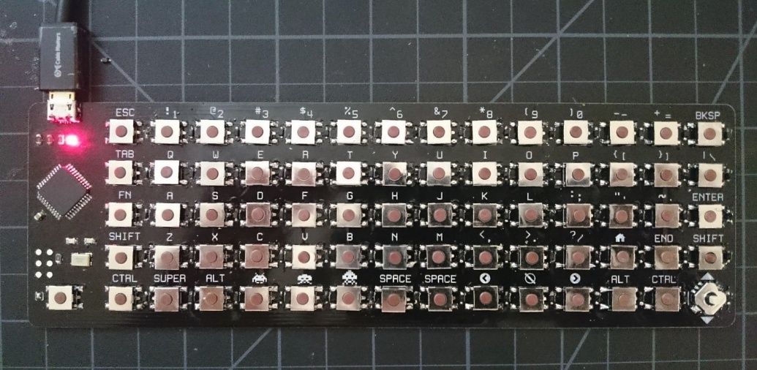
Example : Making your own QWERTY Keyboard using Scanning
Small microcontroller to scan rows and columns and provide USB output
Source: https://medium.com/@monkeytypewritr/building-your-own-keyboard-from-scratch-bd0638c40850

Slide 13
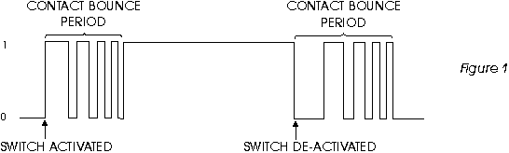
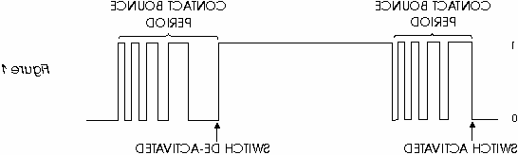
Switch Debouncing
Switches are electrically noisy devices meaning that the same key press could be falsely recognised, either during pressing or during release, due to mechanical “contact chatter”.
This leads to one key press (or release) being detected as multiple key presses.
To address this we usually incorporate a debouncer into the keyboard. This can be done in hardware or in software using a scanning algorithm (or any switch input detection software). See also http://www.ganssle.com/debouncing-pt2.htm
The following software flowchart introduces delays of typically 20mS (which can be tuned to the mechanical characteristics of the switch) between detection of a key being pressed or released and then checks that the same key is still pressed or released.
Contact Close Period
Contact Open Period
Switch Closed
Switch Opened

Slide 14
Keyboard Debouncing Flowchart
Function: GetKeyPress()
Function GET KEY
Debounce old Key Release i.e. check that previous key press has been released before looking for a new one
Debounce old Key Release i.e. check that previous key press has been released before looking for a new one
Count = 10
Scan
Keyboard
Loop checks 10 times over 20ms period to make sure key released (i.e. no bounce on release). Loop restarts if contact made.
Scan
Keyboard
Scan
Keyboard
Count = 0
Key still
Pressed
Key
Pressed?
--Count
2 ms
Delay
Key
Pressed?
Scan
Keyboard
10-100ms
Delay
No
No
Yes
Yes
Wait for and Debounce new Key Press
Count = 10
Wait for and Debounce new Key Press
Scan
Keyboard
Scan
Keyboard
Loop checks 10 times over 20ms period to make sure key pressed (i.e. no bounce on press). Loop restarts if contact broken.
Scan
Keyboard
Key still
Pressed
Count = 0
Key
Pressed?
2 ms
Delay
--Count
Key
Pressed?
No
Yes
10-100ms
Delay
Scan
Keyboard
No
Yes
Lookup
Key
Position
Lookup
Key
Position
Return KEY
Function GET KEY

Slide 15
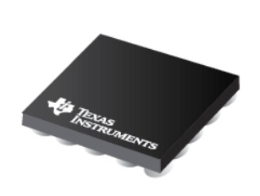
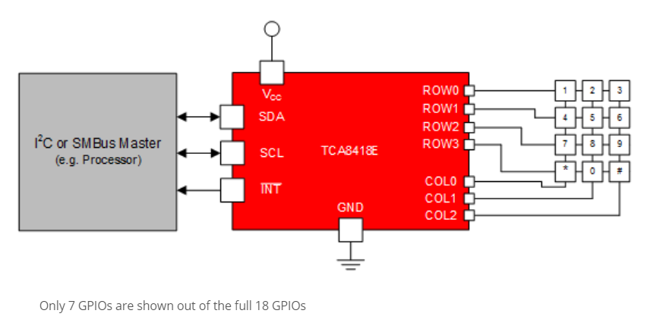
Scan and Debounce IC with FIFO Buffer
Features
Voltage Range of 1.65-V to 3.6-V
Supports 80 Buttons with use of 18 GPIOs
Supports QWERTY Keypad Operation
Low Standby (Idle) Current Consumption: 3 μA
Supports 1-MHz Fast Mode Plus I²C Bus
10-Byte FIFO for up to 10 Key Presses
Interrupt Capability
Integrated Debouncer
Applications
Smart Phones
Tablets
HMI Panels
GPS Devices
MP3 Players
Digital Cameras
Texas Instruments: TCA8418E
I²C Controlled Keypad Scan
IC with debouncer

Slide 16
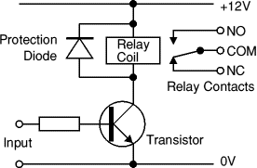
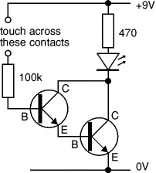
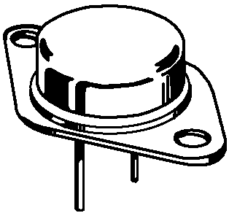
Controlling High Current DC Devices
Because most digital outputs only have low current drive capability, it is not possible to simply connect relays, solenoids or other heavy duty electro-mechanical devices directly to a digital output.
To provide the current needed, we employ a high current gain (>2000) analogue circuit. One solution is to use two transistors arranged as a ‘Darlington pair’, as shown opposite.
The 1st transistor might be fairly basic with a current gain of say 200-300, but the second can be something substantial with a low current gain, like a 2N3055 capable of switching 10-15 amps that may require a substantial heat sink.
A 10 Amp load can thus be controlled while only requiring 5mA from a digital circuit.
https://en.wikipedia.org/wiki/Flyback_diode
'Fly-Wheel' Diode
BC108
Digital Output
2N3055
Darlington Pair high current gain transistor configuration
2N3055
https://en.wikipedia.org/wiki/2N3055
https://www.elprocus.com/darlington-transistor-working-with-applications/

Slide 17
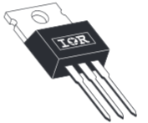
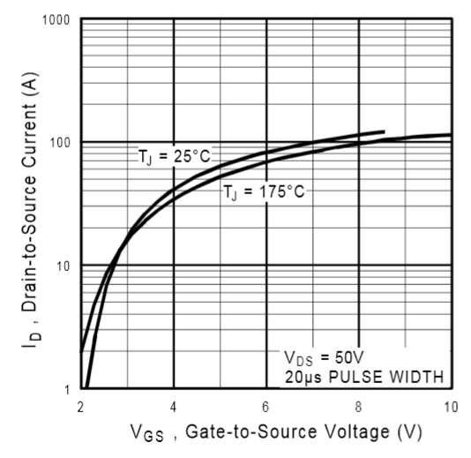
More recently Power Mosfets have developed to the point where their ‘Gate’ can be driven directly from a TTL or CMOS digital output signal.
International Rectifier produce a range of devices with ‘L’ in their part number signifying compatibility with logic level voltages e.g. IRL540
A “pull up” resistor (e.g. 680 ohms as shown opposite) may be needed to fully turn on the Mosfet, if guaranteed output voltages for the digital driver cannot achieve the turn on voltage of 4v (e.g. TTL where min output voltage for a logic 1 is only 2.4v). CMOS circuits may not need that resistor.
For high frequency switching, Mosfet gate current needs to be >1A so an additional current driver may be needed.
https://arduinodiy.wordpress.com/2012/05/02/using-mosfets-with-ttl-levels/
Typical circuit
12v
5v
680
D
Digital Output
G
IRL540N
470
S
0v
On resistance = 0.044 ohms,
I_{max} = 33 amps, V_{DSS} = 100v,
Fully Turned On when V_{GS} = 4v
Fully Turned OFF when V_{GS} < 2v
IRL540N in TO-220 package good for 50 watts

Slide 18
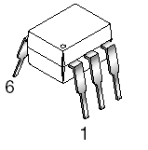
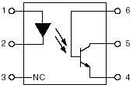
Opto Isolated Outputs
Where protection of the computer is required in high voltage applications, an opto isolator can be used in the output stage to electrically decouple the load from the computer.
This protects the microcomputer, as the only thing likely to get blown up due to an electrical malfunction in the load is the opto isolator.
It also eliminates the need for a common shared ground between computer and load, thus an electrically ‘noisy’ load or power supply (i.e. one inducing glitches and suffering from “ground bounce”) will not affect the microcomputer.
Opto - Isolation
Optically Isolated Computer Outputs
12v
5v
330
Relay
Coil
Computer Side
Load Side
Digital Output
LED
2N3055 or MOSFET
0v
Opto-Isolation

Slide 19
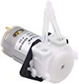
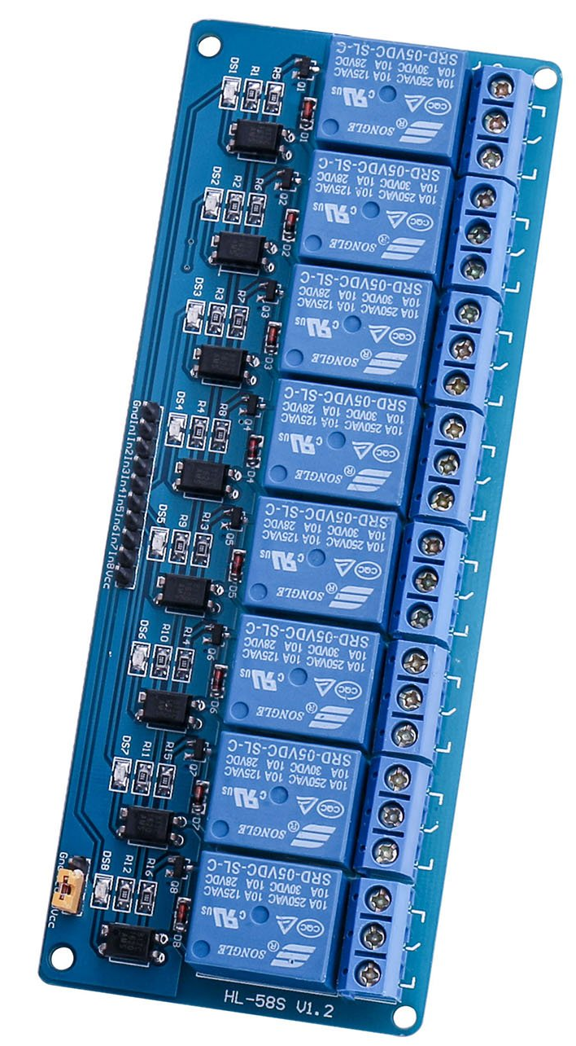
Example Opto Isolated Output Board
ELEGOO 8 Channel DC 5V Relay Module.
Cost (~$14 CDN) from Amazon
Used by one of my CPEN 391 groups last year who mixed cocktails via an Android “app” controlling a Raspberry Pi
Can be controlled by 15mA current
Opto isolator
Solenoid
Motor (load)

Slide 20
Opto Isolated Inputs
The same technique of Opto isolation can also be used to isolate a digital computer input
12v input turns on LED, resulting in transistor conducting and shorting digital input to ground (i.e. a natural inverter is formed by this circuit.)
Optically Isolated Computer Inputs
12v
Input from Load
0v
5v
220
220
5v
0v
To Digital Input
Computer Side
Load Side
0v
0v
Photo Sensitive Transistor forms inverter in this configuration

Slide 21
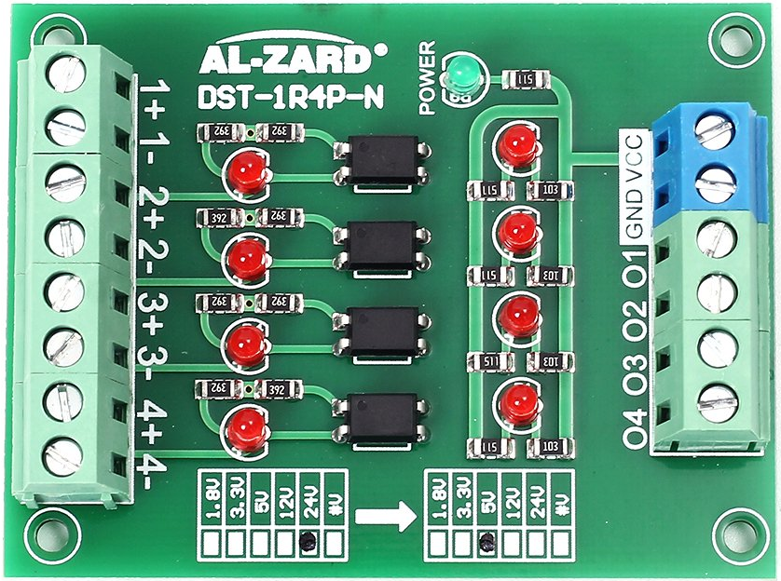
Example; 4 Channel Opto isolation input board: Max 24v inputs, 5v outputs. Cost ~$12 CDN.
Red LEDS are just indicators, nothing to do with isolation.

Slide 22
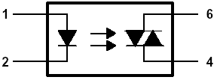
Controlling AC Loads - Opto-Isolated Triacs
For switching AC or high power devices at high frequency, an optically isolated TRIAC can be used, such as the Fairchild MOC3063. This can be driven directly from a computer’s digital output port.
  High Electrical Isolation . . . 7500 V Peak
  Output Driver Designed for 115 VAC
  Load Current Capability 1A
  Applications include Mains Driven low current devices such as simple low power motors, heaters, lights etc.
Power Triacs can be used to control 110-120v AC loads
Electrically Isolated Circuits
5v
100
Load
Computer Supply
115v AC
5v
Triac
Digital Output
0v
LED
0v
Motorola MOC3063
Photo Sensitive TRIAC

Slide 23
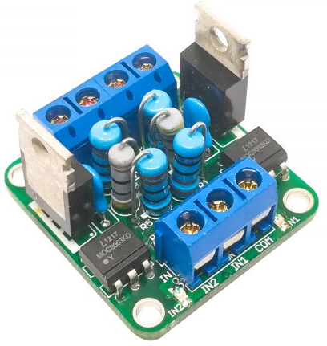
Example Opto Isolated Power TRIAC Module
https://aptinex.com/product/dual-channel-triac-module/
Two channel Opto isolated: 600v and up to 16 amps
Based on MOC3063 Opto isolator and additional power triac: BT139
Cost: < $7.00

Slide 24
Precision Digital Control of High Current Devices
Many devices in the real world require fine grained control in order to operate successfully – not just on or off.
For example, a system designed to control the speed of a motor may require more precision than and a simple on/off digital output provides.
Using DACs
One approach to achieving the level of control required, involves working in the Analog domain using a Digital to Analog converter or DAC to convert a digital representation of a computer generated number (e.g. required motor speed) into a precise analog voltage that can be used to bias a transistor or some other circuit to regulate the current in the motor (and thus control its speed).
Now although this can work well for low current devices, anything more than that is going to generate significant heat in the controlling circuit i.e. the transistor, as well as requiring the expense of a DAC.
Using PWM
For this reason another technique is generally used: Pulse Width Modulation or PWM.

Slide 25
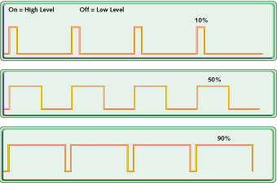
PWM is based around the idea that it is possible to control an Analog device with a high level of precision by controlling the duty cycle of a simple digital output.
The duty cycle is a measure of the ratio of the on time to the period of the waveform, thus a duty cycle of 10% means the output is on for 10% and off for 90% of the time.
By varying the duty cycle, we control the average current that flows in the load like a dimmer switch for an electric light.
Controlling the Duty Cycle
The duty cycle can be controlled in two ways
  Maintain the frequency and adjust the on/off time ratio (as shown opposite) – this is the most common.
  Change the frequency and keep the off time constant.
PWM allows a microcontroller to control high power devices in the Digital domain without having to get involved with DAC’s, Heat and other expensive/complex analogue circuits.

Slide 26
A typical circuit might use the opto isolated output circuit shown previously.
A digital “up/down” counter or timer is used to control frequency and duty cycles. If the frequency is slow, the timer can be done in software, otherwise a dedicated timer chip may be required.
Some single chip microcontrollers have PWM circuitry built in that can be run ‘stand alone’ after programming. If not, it may have to be controlled via timer interrupts and your software.
Pulse Width Modulation Techniques
12v
5v
220
Simple Motor, Heater, Light etc
20% of Max Power
20% Duty Cycle
L
O
A
D
Digital Output
D
LED
G
IRL540N
0v
S

Slide 27
PWM for Motor Speed and Direction Control
Motor Supply (e.g. 12v)
20% Duty Cycle
20% Duty Cycle
D
D
Digital Input A
G
IR540N
20% Forward
IRL540N
G
Digital Input B
S
20% Reverse
S
20% Duty Cycle
+
-
20% Duty Cycle
Motor
D
D
Digital Input B
G
IRL540N
IRL540N
G
Digital Input A
S
S
Motor Supply 0v
H-Bridge Driver Circuit: Note Opto-Isolation and/or pull-up resistors/current drivers not shown for clarity
http://www.modularcircuits.com/blog/articles/h-bridge-secrets/h-bridge_drivers/

Slide 28
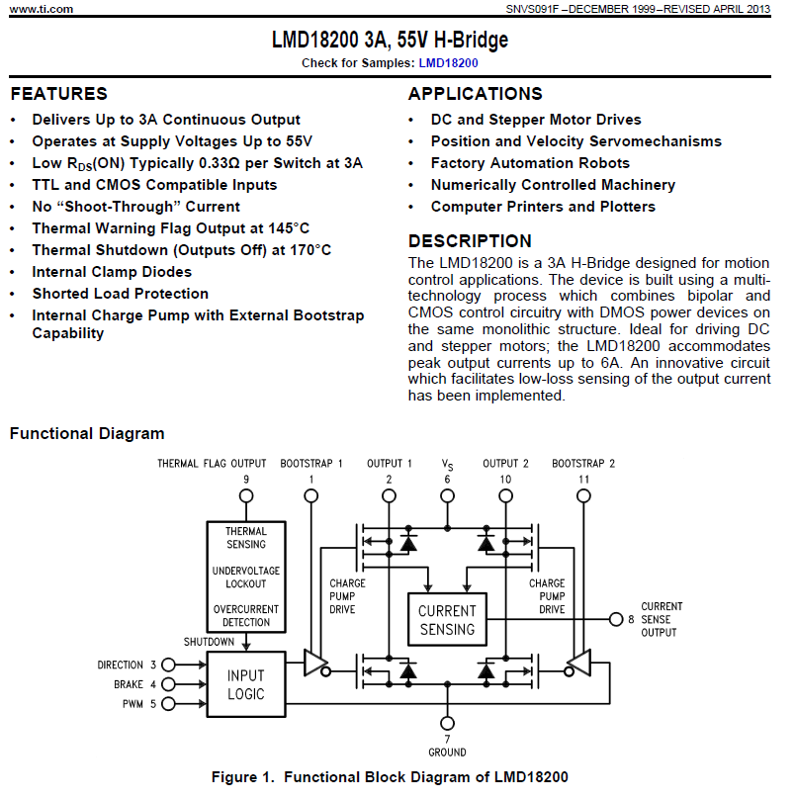
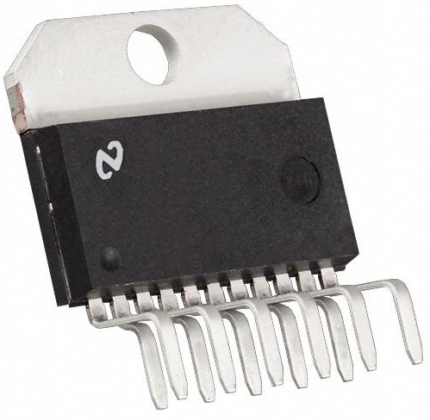
Example H-Bridge Chip for Motor Control
Cost $26 - 1 off pricing
Cheaper IC’s available

Slide 29
Case Study for PWM
Idle Speed Control in a Car Engine

Slide 30
Idle Speed Control Valve (ISCV) in a Car Engine
Many vehicles use PWM within the engine management system to accurately control the setting of an ‘aperture’ in an Idle Speed Control Valve (ISCV).
When a driver lifts their foot off the gas, a throttle plate in the engine air intake will close, starving the engine of air and causing it to slow down or even “stall”. The ISCV prevents stalling by providing a second smaller and adjustable source of air for the engine to breath when the throttle plates are closed.
By adjusting the size of the secondary air intake aperture, the ISCV can regulate the idling speed of the engine in the region recommended e.g. 750-900 rpm.
Note that a ‘fixed size opening’ for the valve aperture cannot be relied upon, since additional engine loads such as Air Conditioning, Windshield Demisters, Lights, Heaters etc. indirectly (via the alternator) place varying mechanical loads on the engine and would serve to drop the idle speed or stall the engine. In other words the aperture opening must be adjusted/controlled in real time, based on feedback of engine speed (i.e. closed loop control).
Similar techniques are used in some cruise control systems where PWM is used to open/close the throttle to maintain a set constant speed for the vehicle irrespective of whether it is travelling up or down a hill (within limits of course).

Slide 31
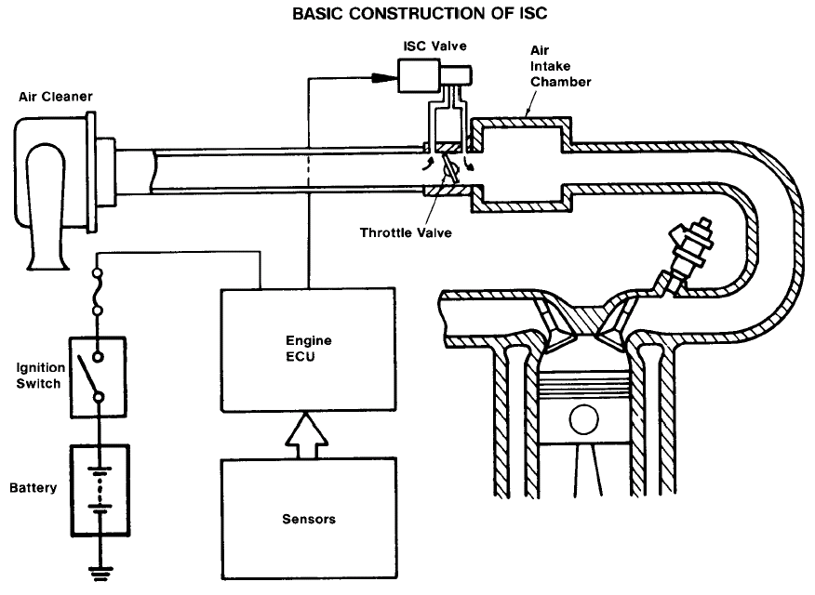
PWM for use with ISC Valve
Secondary air intake controlled by ISCV
Throttle Valve Controlled by Drivers Foot
Input: Engine Speed

Slide 32
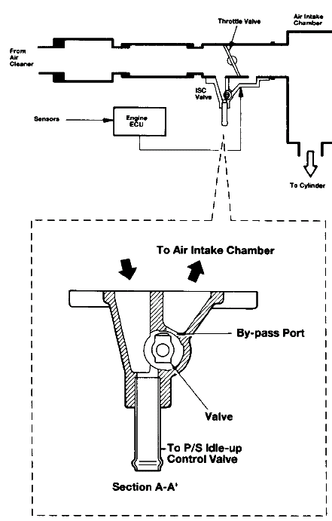
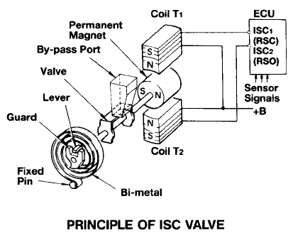
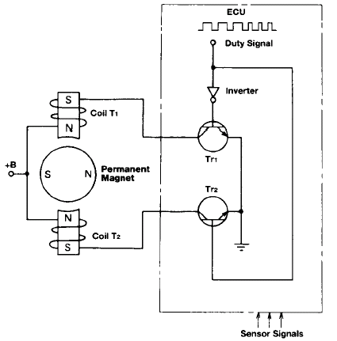
The ISCV consists of a motor and a spring while holds the valve aperture in a neutral safe position, half open/half closed, so that a basic idle can be maintained even if the electronics controlling the valve fail.
By using PWM to drive the motor, it can be made to apply a varying torque against the spring to control the opening of the valve aperture very precisely.

Slide 33
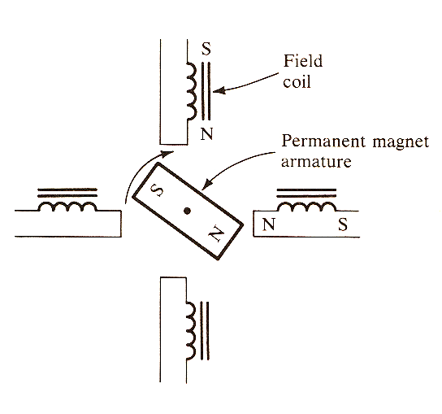
Stepper Motor Control
Stepper motors are digitally controlled motors common in low torque applications.
The motor’s position can be precisely controlled in either closed loop (feedback) or open loop (no feedback) control systems.
Typical applications include plotters, printers, robots, high precision manufacturing tools etc.
An internal representation of a stepper motor is shown opposite.
Currents flowing through the field coils generate magnetic fields that attract or repel the permanent magnet connected to the shaft and cause it to rotate.

Slide 34
To hold the motor in position, the field coils must be energised with a “holding current” to resist slippage and any possible torque created by the load.
Applying a pulse or step produces a higher “step current” in an adjacent coil allowing the magnetic field to increase and turn the motor to its new position. A holding current is again applied to hold the motor in the new position.
Using internal gearing, precisions of better than 1 degree of rotation are possible.
Using a Gearbox has the added benefit of increasing the torque at the shaft at the expense of rotational speed.

Slide 35








By energising each coil in turn, the motor can be made to rotate ¼ of a revolution (for a 4 pole motor). See illustration.
By energising one or more coils together, the motor can be made to rotate 1/8 of a revolution.

Slide 36
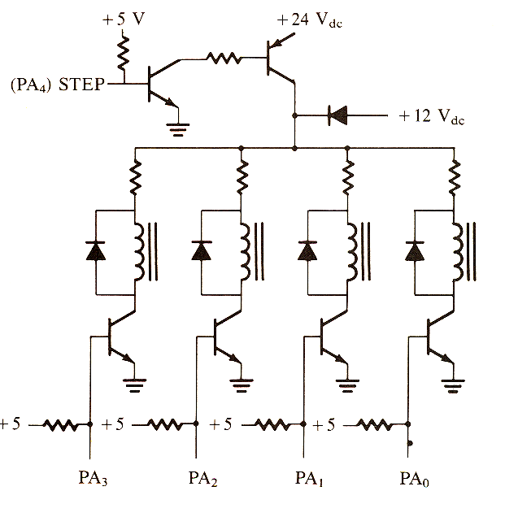
Increases voltge and current to perform a step when ‘step input’ is pulsed to logic 1
Generating the currents in the fields requires a current driver based on Transistors or power MOSFETs which can be turned on-off by a parallel port.
Such a circuit consists of two parts
  A circuit to generate the ‘holding’ current. (the power diode connected to 12v).
  A circuit to generate the higher ‘stepping’ current required to move the motor, (the transistors connected to 24v and the step input)
By controlling the energising of the 4 coils, in software we can control the direction, rotation and speed of the motor.
Supplies holding current to permanently energise coils
Step Input
4 field coils acting as loads
4 bit digital input port driven off a computer parallel output port is used to energise coil(s) and thus control direction, angle and speed of rotation

Slide 37
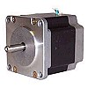
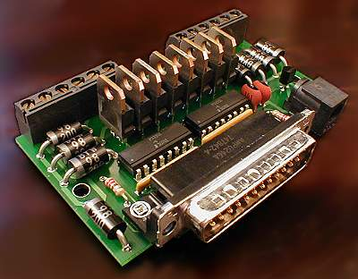
A typical real world stepper motor is shown here.
This one has a gearbox and a resolution of 0.9 Degrees and is just one of a large family of motors made by Nippon.
Also shown is a simple stepper motor controller that was designed to plug into an old PC parallel port. This could just as easily come from a simple parallel port of a microcontroller
This one could control a stepper motor with 8 poles/coild (note the 8 power Mosfets as the field coils require significant current).

Slide 38
Position Control of Motors
When controlling any kind of motor (stepper or AC/DC), there is frequently a need to record the position of the motor. For example
  Robots need to accurately position themselves for welding vehicles.
  Satellite dishes need to be accurately adjusted to receive a signal.
  Elevators need to position and control speed of movement of a motor.
The problem with motor control is that unless some sort of closed loop control is employed (i.e. feedback based on position), it can be difficult to know where the motor is. Even stepper motors can ‘slip’ and lose position.
To be useful, we need methods of monitoring the position of a motor, in terms of its angle of rotation.
Two common methods exist
  Incremental position encoding (i.e. relative position/movement)
  Absolute position encoding

Slide 39
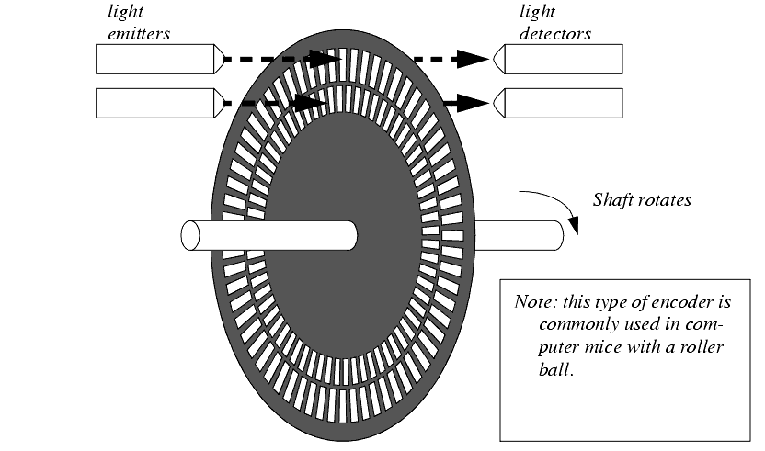
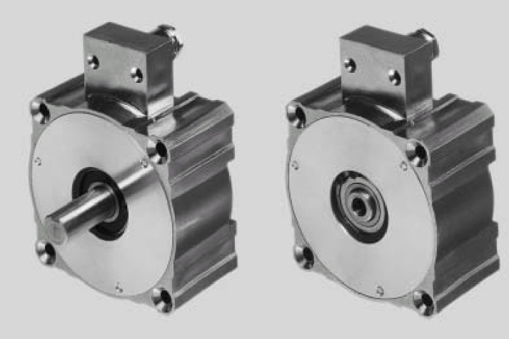
Incremental Encoding
Many incremental encoders incorporate a disc with two out of phase sets of slots cut into it.
LEDs can shine light through these slots which can be detected by optical sensors on the other side of the disc. These in turn can produce pulses which can be used to track speed and direction of rotation and ultimately position.
This is the same kind of encoder that was used in the 1st generation mouse with a “ball”. That had two wheels to detect X and Y movement.
The illustration opposite is that of two incremental encoders made by Pepperl + Fuchs group.
These produce 1250 pulses per revolution and can be attached to the shaft of any motor.
Wheel of an incremental encoder

Slide 40
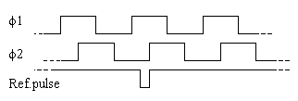
Incremental Encoding
The technique relies on two 90 degree ‘out of phase’ signals being generated by an encoder connected to the shaft of the motor as it rotates (see illustration). One serves as a
clock (for counting purposes), the other as an indication of direction.
The phase and frequency of these two signals gives an indication of direction, speed and if tracked correctly, the angle of rotation.
A ‘Ref pulse’ can be generated when the motor is at a set position for calibration purposes.
The pulses usually control an up/down counter which can either be implemented in software or (for high speed applications) in hardware.
The value of the counter thus records the angular rotation of the motor and hence the position of anything it is controlling.
Anti-Clockwise Rotation
Clock
0
0
0
Direction
0
1
2
3
Count
Rising edge of Clock occurs when direction = 0
Clockwise Rotation
Clock
1
1
1
Direction
0
1
2
3
Count
Rising edge of Clock occurs when direction = 1

Slide 41
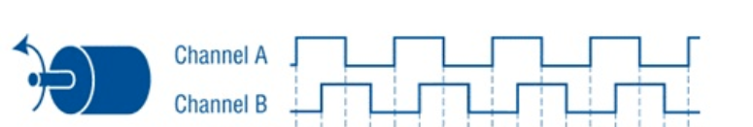
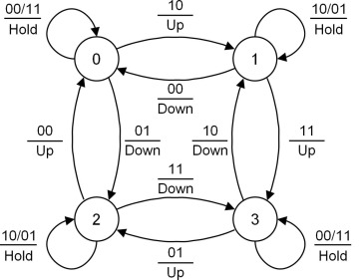
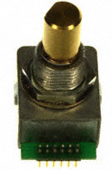
Quadrature Encoding
Using both the leading and the trailing edges of both encoder channels will quadruple (x4) the number of edge transitions per revolution. These two channels serve as inputs to a hardware state machine with 4 states. e.g. If state = 3 and input = “01” then increment count and move to state 2 otherwise, if input = “10” then decrement count and move to state 1.
As a result, 10,000 pulses per revolution can be generated from a 2,500 PPR Quadrature Encoder and thus 4 times the position accuracy.
1
1
0
0
1
1
0
0
0
1
1
0
0
1
1
0
Edge Count
1
2
3
4
5
6
7
8
9
10
11
12
13
14
15
16
17
State (forwards)
0
1
3
2
0
1
3
2
0
1
3
2
0
1
3
2
0
State (reverse)
0
2
3
1
0
2
3
1
0
2
3
1
0
2
3
1
0
Example Rotary Encoder (goes round and around forever).
Used in many instruments like Oscilloscopes.

Slide 42
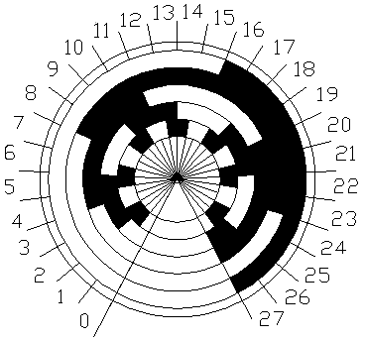
Absolute Encoding
This technique gives an absolute indication of motor angle.
The technique uses a ‘Gray’ encoded wheel to provide absolute values. The illustration opposite is of a 5 bit wheel. (Note only codes 0-27 of 32 have been shown). This gives it a resolution of 11.25 degrees of rotation.
Gray codes differ from binary codes in that counting up or down causes only a single bit to change at a time.
An example of counting up using Gray codes is given below
  000
  001
  011
  010
  110
  111
  101
  100
Gray codes eliminate errors when the disc is positioned at an angle close to the edge of a code change since only 1 bit can change for each angle of rotation and therefore the error is +/- ½ an angle of resolution.

Slide 43
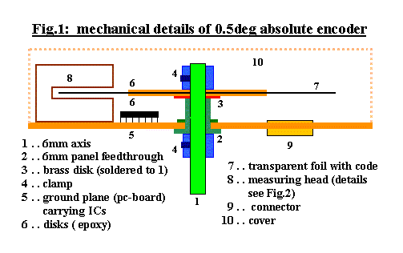
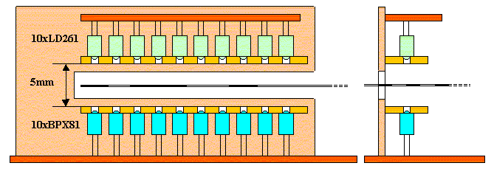
Position Control of Motors
The illustration below is a student project found on the web. It shows a motor attached to a 10 bit sensor/gray code wheel with better than 0.5 degree resolution.

Slide 44
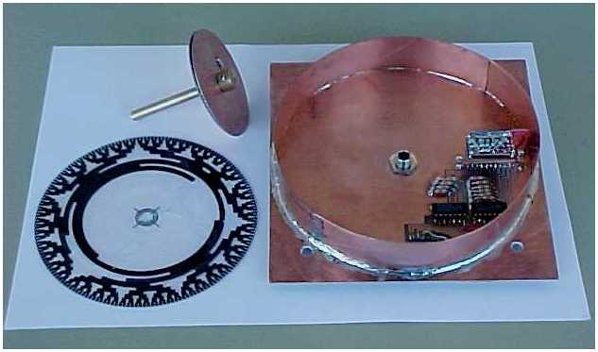
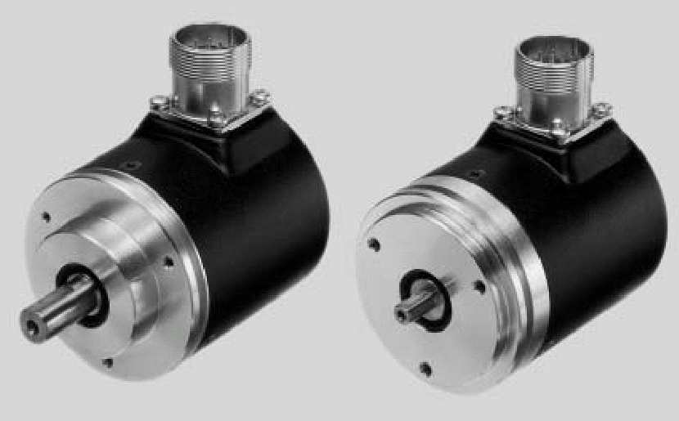
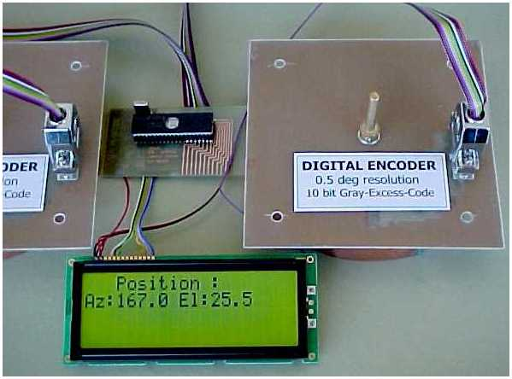
Position Control of Motors
The 1st illustration is of the 10 bit wheel used within the encoder wheel itself.
The 2nd illustration is of the completed system being used to accurately position a satellite receiver dish.
The 3rd illustration is of two commercial products with 13 bit resolution. These are equipped with a serial interface for communication with a computer which will give “Position-on-Demand”

